Slide 1
作文生成器
Nlp作业
杨越千 闵映乾 龚政

Slide 2
Motivation
给出一篇作文的要求(主题)，能否由机器自动完成写作?
一篇作文的主要内容(议论文)：
开头：概括诠释作文主题，引出下文
中间：详细阐述各分论点
结尾：总结论点，完善作文主题

Slide 3
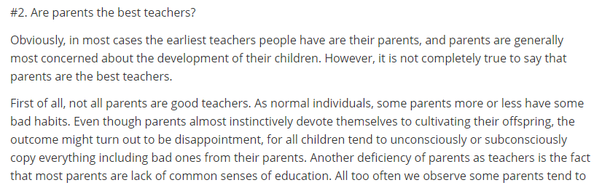
Data & model
Toefl 作文约200篇, 每篇约400词
短标题 ——
段落 ——
标题一般为一个较短的选择性质的疑问句
使用预训练好的经典GPT-2进行文本生成任务，在数据上fine-tuning

Slide 4
Train & Test
TASK1: auto-paragraphing generator
TASK2: parallel viewpoint writing
Input: [title] \n [para1] \n [para2] \n …
Input: [title] [para1] //title预测开头
[title] [para1] [para2] //开头预测中间段
[title] [para1] [para3]
…
将title和每段之间用\n隔开,\n作为分隔符
Test:
输入[title]作为前缀，后续自动生成一段文本
使用Beam search筛选下一个合适单词
通过title生成开头，开头确定了文章的主要论点
后续段采取不同的论点，在结构上是平行的，因此可以分别由开头生成
Test:
输入[title]作为前缀，后续自动生成一段开头
开头分别生成若干后续段
(对未成型的句子作截断处理)

Slide 5
Compared with raw text
Learn by yourself or with a teacher?
Whether we need a teacher or not depends on circumstances. The relationship between a teacher and a new subject is somewhat similar to that between a tour guide and an unknown city.
When we come to an unknown city for the first time, we definitely need a tour guide. We might have a detailed map, but it is unlikely functional—it isn't surprised that we can hardly interpret those mysterious symbols. Likewise, when we are beginners, it is wise to learn with teachers. They can tell us where to begin with, what we should do, and which reference we should choose. When we confront difficulties, we can ask them for help, and their advices will always be tremendously helpful. With teachers' assistance, we might learn easier, faster, and more interestingly.
…
我们是否需要老师取决于环境。老师和一门新学科的关系有点类似于导游和一个陌生城市的关系。
当我们第一次来到一个陌生的城市，我们肯定需要一个导游。我们可能有一张详细的地图，但它不太可能有用——我们很难解释那些神秘的符号，这并不奇怪。同样，当我们是初学者时，跟老师学习是明智的。他们可以告诉我们从哪里开始，我们应该做什么，我们应该选择什么参考。当我们遇到困难时，我们可以向他们寻求帮助，他们的建议总是非常有帮助的。有了老师的帮助，我们可能学得更容易、更快、更有趣。
Raw text

Slide 6
Compared with raw text
Learn by yourself or with a teacher?
In most cases it is more beneficial for a young person to spend his/her free time with his/her teachers. The teacher is there to give guidance and help the young person, and to encourage the young person to think critically about what he/she is learning.
Teachers, on the other hand, can give young people the opportunity to develop their ideas and ideas are very powerful. They are able to introduce ideas that might not have been considered at first, and allow the youth to explore his/her own ideas in an open environment. In addition to these two advantages, I believe that having a teacher around also has its own advantages.
…
在大多数情况下，一个年轻人和他/她的老师度过他/她的空闲时间是更有益的。老师在那里给予指导和帮助年轻人，并鼓励年轻人批判性地思考他/她正在学习的东西。
另一方面，教师可以给年轻人机会发展他们的想法，而想法是非常强大的。他们能够引入一些最初可能没有考虑到的想法，并让年轻人在一个开放的环境中探索自己的想法。除了这两个优势之外，我相信有老师在身边也有自己的优势。
Generated text

Slide 7
Task1 vs Task2
TASK1
Learn by yourself or with a teacher? (agree with teacher)
…
Finally, teachers have a special responsibility to educate their student's parents. If a parent cannot take care of their child, the child will be at a disadvantage to any other child. If a parent cannot afford to take care of a child, the child will be deprived from learning. …
TASK1对每段论点的捕捉比TASK2更好；段落间整体性更强
最后，教师负有教育学生家长的特殊责任。如果父母不能照顾自己的孩子，
那么孩子就会比其他任何孩子都处于不利地位。如果父母负担不起照顾孩子
的费用，孩子就会被剥夺学习的权利。…
Learn by yourself or with a teacher? (agree with teacher)
…
It is possible to learn something only when the situation demands attention. For example, in order to learn a foreign language, I often learned the language by listening to lectures on the history of Chinese culture, the achievements of the Chinese Revolutionary Army, and the lives of important historical figures in China…
TASK2对随机性要求更高，导致生成文段质量波动较大(受开头影响较大)
TASK2
只有当情况需要注意时，才有可能学到一些东西。例如，为了学一门外语，我经常
通过听中国文化史、中国革命军功绩、中国重要历史人物生平等讲座来学习语言。…

Slide 8
More/less specific contexts
Less specific title:
Learn by yourself or with a teacher?
more specific title:
Which do you think is better, learning by yourself or with a teacher?
I have always loved learning by myself. However, sometimes when my friends and family were around, we were able to learn together. We would sit in groups and play games together, and we would talk together.
It's difficult to decide which one is better. I think a lot of people find the first one to be a little bit too much work, while the latter one is easier and is definitely preferable in many cases. I personally prefer the latter.
我一直很喜欢自学。然而，有时当我的朋友和家人在身边时，
我们能够一起学习。我们会成群结队地坐在一起，一起玩游
戏，一起聊天。
很难决定哪个更好。我认为很多人发现第一个工作量有点大，
而后一个更容易，并且在许多情况下绝对是可取的。我个人
更喜欢后者。
加入更多信息能够提升机器对于文章的理解(记叙文/议论文)

Slide 9
Diversity between paragraphs
Which do you think is better, learning by yourself or with a teacher? (TASK1)
…
In my opinion, learning through a teacher is much easier and quicker. I would prefer to learn the same material in a class with a teacher than I would do alone. In fact, I prefer to take the time to teach with a teacher because it's easier to learn and because there's a greater understanding and understanding is a great feeling. When I am in class with a teacher, I find that I have a much clearer understanding of what I'm trying to learn. For example, one of my favorite subjects when I am in class is reading. I find that if I am sitting alone in class, I have very little idea of what I'm supposed to do.
Teaching also allows me to learn new subjects that are not readily available in my school. For example, if I am interested in a certain subject, it is much easier for me to learn a foreign language than a subject that I'm familiar with in school, such as chemistry. I find that I am much more knowledgeable about these topics when I teach with a teacher. In addition to the knowledge gained from learning with a teacher, a teacher also provides the opportunity to have fun. For example, when my friends and I go to the movies, I enjoy the company of my friends a lot more because they know exactly what I am doing during our movie sessions.
Finally, a teacher has more of a hand in the learning process. For instance, if a person is studying the same material, they are bound to get the same result. When I'm doing my own study, for example, I can see the same ideas coming together. In this way, a teacher has more insight into the subject matter, and therefore, is able to give the subject a more correct answer.
Overall, however, I think that learning a new subject by yourself is the best way to learn a subject. I think this is because there is a much greater understanding and understanding of the material when a teacher is there. In addition, if you have an experienced teacher there you can always take the time to learn a subject by yourself. In the end, I think learning a new subject by yourself is definitely the best choice. If one of your friends or family members are interested in the topic, they will definitely find a way to learn it too.

Slide 10
conclusion
机器能够学习作文信息，并书写具有一定逻辑的议论文段
整体上，在生成中篇英语作文(<=500词)任务中具有良好表现
偶尔仍然会生成一点离题段落，取决于前置上文信息(title)的准确/充分程度

Slide 11
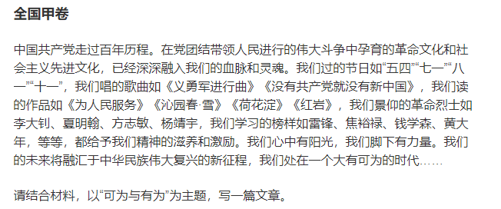
Usage with 2021 gaokao composition
In the coming years, we will see a new era of development in China. The Chinese people have come a long way in a generation. We have seen the power of new ideas, inventions and technologies. China will become a more prosperous and advanced country. The Chinese people will become more knowledgeable about the world, and their ability to solve problems will increase. …
(google translate)
未来几年，我们将看到中国发展的新时代。中国人在一代人的时间里走过了漫长的道路。我们已经看到了新想法、发明和技术的力量。中国将成为一个更加繁荣和先进的国家。中国人对世界的了解会越来越多，解决问题的能力也会越来越强。…
The Communist Party of China has gone through a century of history. The revolutionary culture and socialist culture nurtured in the moral education carried out by the party in uniting the people and the masses have already deeply understood our blood and heritage. We have sunshine in our hearts, and power under our feet. Our future will be integrated into the new journey of the great rejuvenation of the Chinese nation. We strive for an era with great opportunities...
What do you think you can do and have to do?
What do you think you can do and what would you do?
GPT2

